Slide 1
Distribution of Veriflow
Junyi Peng
Xingyang Liao
Weishu Cheng

Slide 2
Progress：
1. platform setup
2.baic method
3.function analysis
controller
controller
veriflow
veriflow

Slide 3
Two
Controller
NW1 NW2
controller
controller
veriflow
veriflow
X
U
A
B
V
Y

Slide 4
Function analysis
controller
controller
Main function
MutipleVeriFlowVerify()
ConnectionCheck()
Pair_info()
veriflow
veriflow
A
B

Slide 5
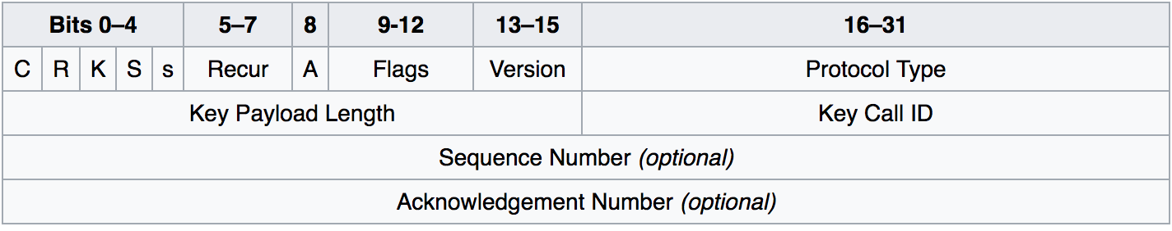
Connect two Mininet network with GRE tunel
Generic Routing Encapsulation(GRE): a tunneling protocol that can encapsulate a wide variety of network layer protocols inside virtual point-point links over an Internet Protocol network.

Slide 6
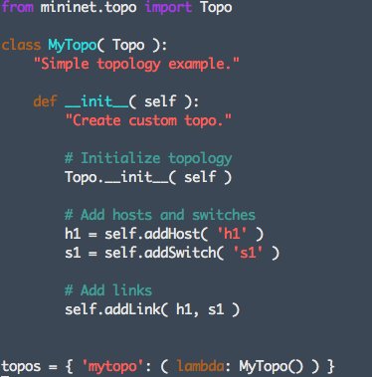
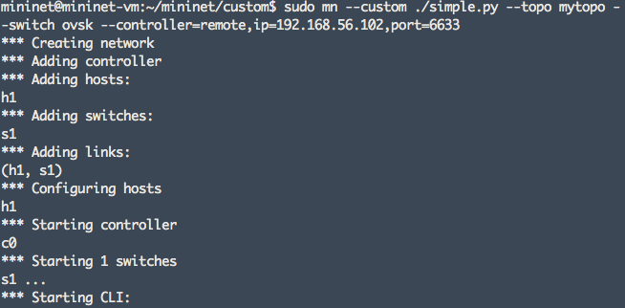
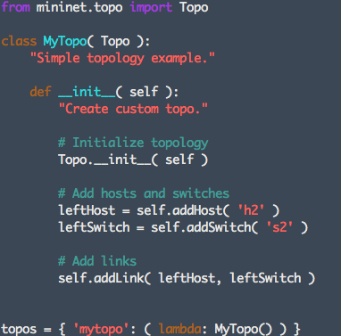
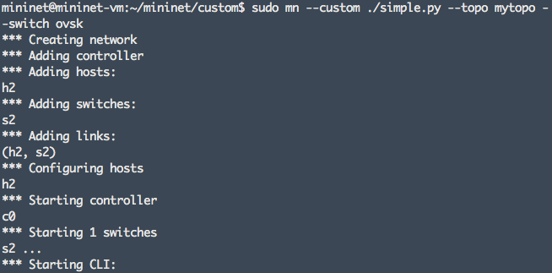
Set the environment
VM1(Virtual Box 192.168.56.101)
  Host1
  Swtich1
VM2(Virtual box 192.168.56.102)
  Host2
  Swtich2
Start Mininet:

Slide 7

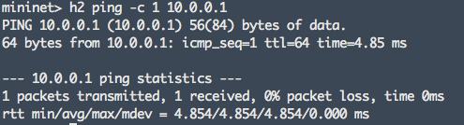
Connect
Two Mininet
&Connected Two Mininet Network
Make host IP different
Set the tunnel
  VM1
  VM2
3. Connected

Slide 8
Thank you
Reference：
-https://techandtrains.com/2013/09/11/connecting-two-mininet-networks-with-gre-tunnel/
-chrome-extension://ikhdkkncnoglghljlkmcimlnlhkeamad/pdf-viewer/web/viewer.html?file=http%3A%2F%2Fpbg.cs.illinois.edu%2Fpapers%2Fkhurshid13veriflow.pdf

